Slide 1
Module 3
Accountability Avenues and Remedies
INTERNATIONAL PROTOCOL
PART III – SEXUAL VIOLENCE UNDER INTERNATIONAL LAW
PAGES 28-39

Slide 2
Session objectives
Define sexual violence as a violation or crime under international law
Describe rights of CARSV victims and key accountability avenues/remedies available
Explain different legal frameworks applicable to CARSV and their interplay

Slide 3
Sexual violence under international law
Depending on the circumstances, sexual violence may amount to a war crime, crime against humanity, act of genocide or other violation of international law
Rape and other forms of sexual violence are prohibited as a matter of customary international law at all times (both in times of peace and conflict)
Sexual violence is also prohibited under various international legal instruments and further defined by jurisprudence

Slide 4
What international legal regimes apply to CARSV?
International criminal law
Individual criminal responsibility
War crimes, crimes against humanity or genocide
International human rights law
State responsibility for acts or omissions, incl. failure to prevent or respond to violations
Human rights violations
International humanitarian law
Governs the conduct of hostilities
Remedy can be criminal prosecution of individual perpetrators and awards of damages
Remedy can be an action against the responsible state and reparations
Serious violations of IHL constitute war crimes under int. criminal law
Remedy can be criminal prosecution of individuals or civil action against the state
Responsibility of parties to a conflict (states/non-state organised groups)
These various regimes complement each other and can apply simultaneously

Slide 5
What makes an act an international crime or violation?
International law describes acts of sexual violence and also which categories of crimes or violations such acts may amount to under international law
Factual circumstances will determine whether an act of sexual violence can amount to a violation or crime under international rather than ‘ordinary domestic’ law (e.g. sexual violence committed in conflict or as part of an attack against a civilian population)
Domestic laws may not be in line with international standards

Slide 6
Why is it important?
As a matter of customary international law, victims of sexual violence amounting to gross violations or serious crimes under international law are entitled to:
- equal and effective access to justice
- adequate, effective and prompt reparation
Other legal consequences of a qualification as an international crime may include:
- inapplicability of statutory limitations or prescription
- application of principle of command responsibility
- application of principle of universal jurisdiction
Notes:
Universal jurisdiction as a tool to fight impunity: International Protocol Chapter 3, Box 2

Slide 7
What are states’ obligations?
Module 5 – State Responsibility and Module 6 - Reparations
States are obliged to respect, protect and fulfil the rights guaranteed in human rights treaties which they have ratified or in customary international law
States bear the primary responsibility to investigate and prosecute perpetrators of sexual violence, including CARSV - complementary role of the ICC (but relationship between states and other international or hybrid courts may be different)
States also have the obligation to provide effective remedies and reparations to victims of CARSV for acts or omissions which can be attributed to them

Slide 8
What factors determine the range of accountability options?
Accountability mechanisms available to CARSV victims may depend on the following
Applicable legal framework in the country where the crimes took place
Other regional/international instruments ratified
Possible exhaustion of domestic remedies
Response by the international community (e.g. hybrid tribunal, commission of inquiry, etc.)
Ratification of the Rome Statute of the ICC
Date of commission of the crimes, circumstances of the act and type of victim (e.g. CEDAW not open to male victims)

Slide 9
What different forms can accountability take?
Human rights courts
Domestic criminal courts
International and hybrid courts
National human rights institutions
Fact-finding bodies
Human rights committees
Civil or constitutional courts
Interstate fora
9

Slide 10
What different forms can accountability take?
Non-judicial
- Commissions of inquiry
- Special rapporteurs, UPR, listing by the SRSG SVC/CAC
- NGO documentation and advocacy
- Missing persons identification processes
- Security sector vetting and reform
Quasi-judicial
- National human rights institutions
- Reparations programmes
- Regional human rights mechanisms
- UN Treaty Bodies
- Truth and reconciliation processes
Judicial
- Domestic criminal, civil or constitutional courts
- Regional human rights courts
- International and hybrid courts and tribunals

Slide 11
What different forms can accountability take?
Accountability can result in criminal responsibility, state responsibility or both – to be understood broadly
Documentation of CARSV should not only aim at successful prosecution but should also support reparations claims by documenting the full range of harm suffered
CARSV victims can seek justice and reparations at the domestic, regional and/or international level
Seeking accountability through quasi and non-judicial mechanisms may ultimately lead to criminal accountability and other judicial responses & legally binding decisions

Slide 12
What different forms can accountability take?
➔Protocol’s methodology primarily aimed at supporting criminal prosecution, but it can serve other accountability avenues; it aims at the highest standard of best practice
➔Certain accountability avenues may be used in parallel while others are exclusive of each other
➔Documentation can also help secure evidence for future processes (which may not even exist at the time)
Different accountability mechanisms have different mandates, substantive law, admissibility & evidentiary requirements, etc.

Slide 13
What are some domestic accountability avenues?
Module 4 – Individual Criminal Responsibility
Module 5 – State Responsibility and Module 6 - Reparations
Claim administrative compensation from a trust fund for victims
File a criminal complaint to prompt prosecution
File a constitutional case for compensation from the state for failure to investigate and prosecute or force the authorities to investigate
Provide information to a truth and reconciliation commission
Provide information to a national fact-finding mission
File a civil case for compensation or other forms of reparation

Slide 14
What are some human rights accountability mechanisms?
Module 5 – State Responsibility and Module 6 - Reparations
Judicial
legally binding decisions
Regional human rights courts e.g. ACtHR, ECtHR, IACtHR
Sub-regional human rights courts e.g. ECOWAS Court
Quasi-judicial broad recommendations
UN Treaty Bodies e.g. HRC, CAT, CEDAW, CRC
Non-judicial non-binding communications
UN Special Procedures e.g. special rapporteurs
Universal Periodic Review
Regional human rights commissions e.g. ACHPR, IACHR
Committees/working groups of regional systems
Notes:
Judicial
African Court on Human and Peoples’ Rights (ACtHR)
European Court of Human Rights (ECtHR)
Inter-American Court of Human Rights (IACtHR)
Community Court of Justice of the Economic Community of West African States (ECOWAS Court)
East African Court of Justice (EACtJ)
Quasi-judicial
Human Right Committee (HRC)
Committee against Torture (CAT)
Committee on the Elimination of Discrimination against Women (CEDAW)
Committee on the Rights of the Child (CRC)
African Commission on Human and Peoples’ Rights (ACHPR)
Inter-American Commission of Human Rights (IACHR)

Slide 15
What human rights violations can CARSV give rise to?
Module 5 – State Responsibility and Module 6 - Reparations
Prohibition from torture & inhuman treatment
Right to life
Right to health
Right to equal protection under the law
Right to an effective remedy and reparation
Right to personal security
Right to physical integrity
Right to non-discrimination

Slide 16
What international underlying crimes can CARSV give rise to?
Module 4 – International Criminal Responsibility
Annex 1- Evidence Workbook
Rape
Murder
Torture
Sexual slavery
Forced conjugation or forced marriage
Enforced prostitution
Persecution
Other forms of sexual violence

Slide 17
What is the role of fact-finding bodies?
Investigative and fact-finding bodies can be set up by the United Nations, regional or national authorities
Mandate to investigate human rights violations and/or international crimes in a specific country or region
Their reports usually provide recommendations for best way to ensure accountability
May lead to setting up of international and hybrid courts & tribunals or domestic criminal prosecution

Slide 18
What is the role of international courts and tribunals?
Module 4 – Individual Criminal Responsibility
Module 5 – State Responsibility and Module 6 - Reparations
International Criminal Court
Permanent court of last resort – principle of complementarity
Jurisdiction for international crimes committed after 1.07.02
Ad hoc & Hybrid Tribunals
International Court of Justice
UN judicial organ - deals with interstate disputes
Created by UN Security Council or agreement between a state and UN or regional organisation
Not generally available to individuals or groups
Temporary criminal courts - deal with specific situations

Slide 19
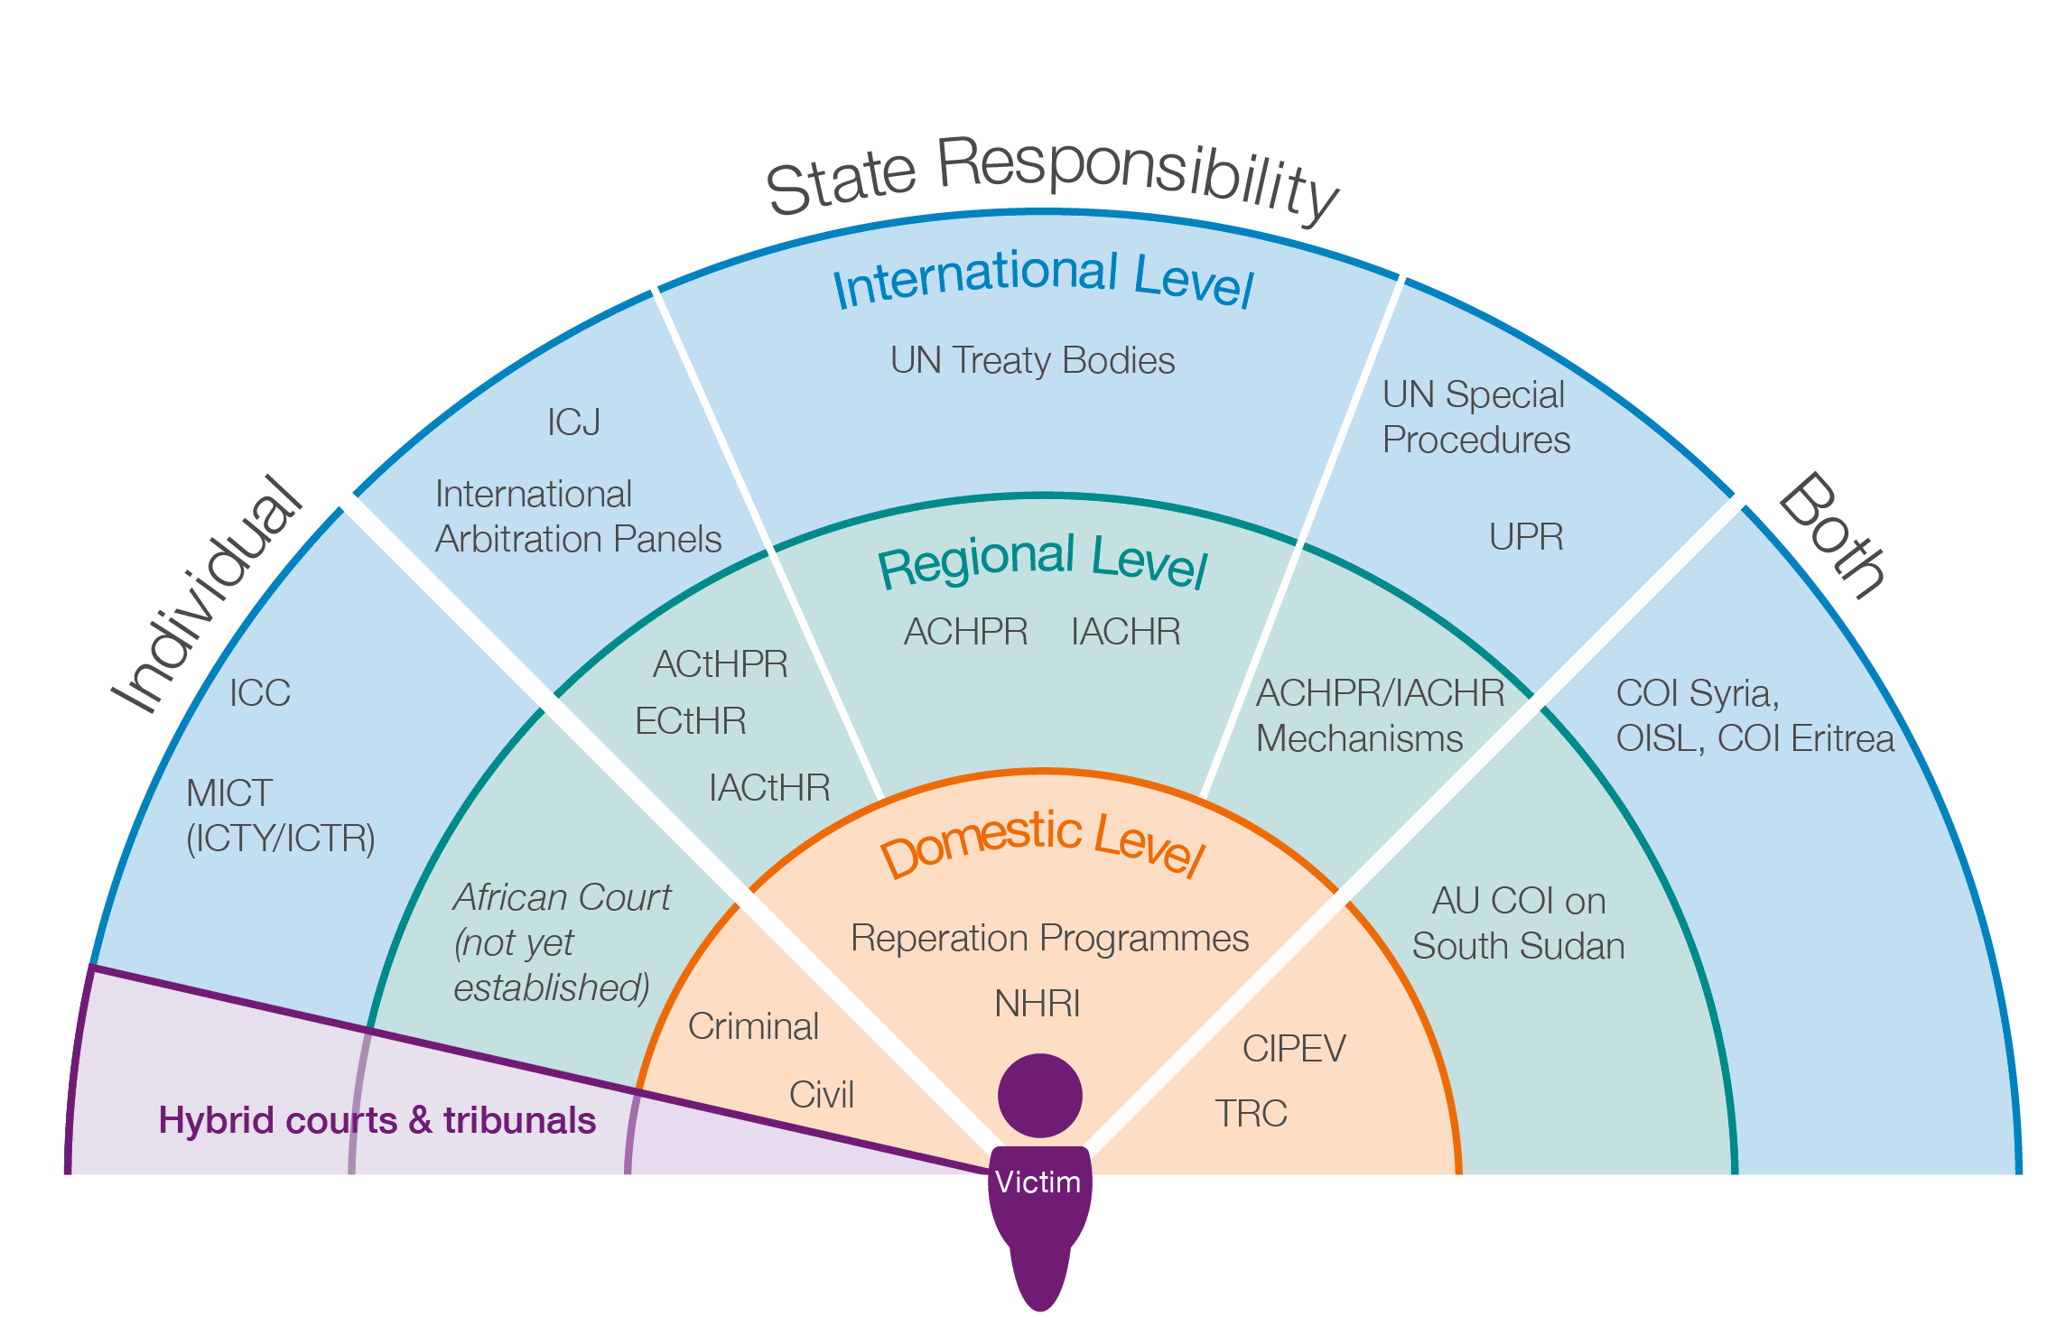
Overview of Accountability Avenues and Remedies

Slide 20
Exploring accountability avenues and remedies
EXERCISE
Think about and discuss accountability mechanisms you are familiar with and categorise them by answering the following questions:
What type of responsibility is this body dealing with?
Are its decisions legally binding?
If not, what authoritative value do they have, or what value may they otherwise have for victims?
Is it a domestic, regional or international body?
What types of remedies will it deliver to victims?

