Slide 1
Module 7
Do No Harm
INTERNATIONAL PROTOCOL
PART IV – DOCUMENTATION IN PRACTICE: PREPARATION
PAGES 84-103

Slide 2
Session objectives
Recognise the fundamental importance of the Do No Harm principle and a survivor-centred approach to documentation
Identify categories of measures to prevent, mitigate or respond to potential harm
Explain what informed consent means and when and how to obtain it

Slide 3
What does it mean to
Do No Harm?
International Protocol, page 85
The key ethical principle of Do No Harm should guide any CARSV documentation process – it is a minimum requirement
Do No Harm means:
thinking carefully about all possible negative impacts of documentation on victims/witnesses, the wider community and documentation team;
being prepared for the harm those impacts may cause; and
making every possible effort to prevent, minimise or respond to potential harm, or dropping documentation or aspect of it if harm cannot be prevented or appropriately minimised.

Slide 4
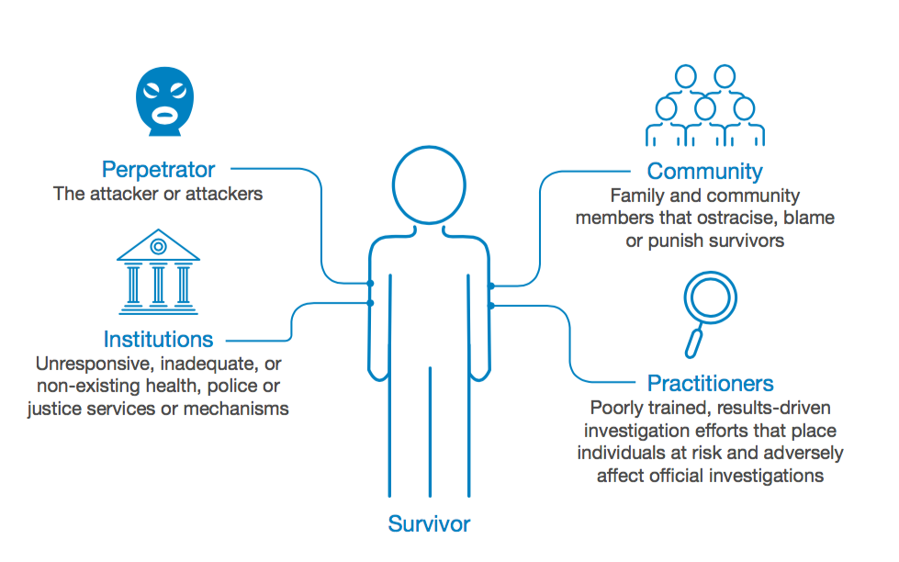
Who causes harm to
CARSV survivors?
Notes:
Please refer to the table on page 87 of the International Protocol, Chapter 7, for examples of types of harm and who causes it.

Slide 5
What does it mean to
respect survivors’ autonomy?
Do No Harm requires adopting a survivor-centred approach and supporting survivors’ autonomy by prioritising their needs/ requests
Survivors’ decisions may sometimes appear to result from family/cultural pressures and not to be in their best interest
Fully inform survivors, discuss all risks/benefits of participation & support them in accessing services to ensure they make the best possible decisions for themselves - you may not agree with their decisions but their wishes should be respected
Respecting survivors’ autonomy means recognising their right and ability to make independent decisions and take action based on their own personal values and beliefs

Slide 6
What does it mean to
Do No Harm?
Informed consent
Do No Harm
Mitigating harm
Some risks are inherent to CARSV documentation and cannot be avoided – a full disclosure of all possible risks to victims/witnesses is therefore critical
Respecting the principle of Do No Harm does not necessarily mean that CARSV documentation should not be pursued - victims may be vulnerable but they can be empowered by telling their story and pursuing accountability – that’s their decision

Slide 7
Informed consent –
what it means?
Informed consent means that CARSV victims/witnesses have the ultimate authority to decide if and how they wish to participate in the documentation process
Legal and ethical obligation to obtain informed consent derived from the principle of autonomy
It requires victims/witnesses to give voluntary consent on the basis of full disclosure and understanding of all stages and aspects of the documentation process
Permission of a legally authorised representative may be sought for individuals incapable of giving informed consent (e.g. young age, disability or mental illness) – children with sufficient maturity may be required to provide informed assent
Notes:
Fundamentals of informed consent, International Protocol Chapter 7, Box 2

Slide 8
Informed consent –
what it means?
Informed consent is a process and involves
STAGES
Witnesses to consent to
be interviewed and have their information recorded
ASPECTS
Witnesses to fully understand
purpose of documentation & intended use of information
be photographed and/or examined
be referred to support services/have information shared with third parties
meaning and limits of confidentiality
risks and benefits of participation

Slide 9
Informed consent –
what negates it?
Consent is not informed or voluntary:
if obtained based on lies, deceit or partial disclosure of potential risks or other information - whether malicious or not;
when despite full disclosure, the witness did not fully understand the facts (e.g. limited capacity, language issues, bad communication, etc.); or
in situations of coercion or inducement (e.g. threats to withdraw assistance or to provide support in return for information).
Information obtained without securing informed consent may not be admissible in court or before other mechanisms

Slide 10
Informed consent –
top tips
Ensure victims/witnesses feel comfortable enough to refuse and clearly explain that they have a choice
Take time to explain all relevant factors and give them enough time to make a decision - allow them to change their mind
Offer them opportunities to ask questions and share concerns
Fully explain purpose of documentation and all possible uses of information, including possible obligations to disclose (e.g. children)
Explain benefits & risks of participation and limitations of services provided
Obtain explicit consent for specific activities (e.g. using tape recorder, doing a physical examination, taking pictures of injuries, referring the victim, etc.)

Slide 11
B. How to mitigate harm?
Those documenting CARSV have an ethical professional responsibility to put in place measures to prevent, mitigate or respond to potential harm caused by themselves and institutional/social actors as well
Mitigating measures
Threat and risk assessments
Coordination
Confidentiality
Referrals of victims/witnesses
Notes:
Mitigating harm, International Protocol Chapter 7, Box 3

Slide 12
B. Mitigating harm –
threat and risk assessments
International Protocol, pages 92-93
Module 8 – Safety and Security and Module 9 - Planning
Annex 2 – Conducting Threat and Risk Assessments
During the planning phase, it is your responsibility to conduct careful and thorough threat and risk assessments for those with whom you will interact, your own team and your information
Threat and risk assessments should be carried out repeatedly throughout the documentation process
Assessing risks means identifying potential threats, assessing what is the risk or likelihood that the threat will materialise and its impact, and putting in place measures to counter identified potential risks
Notes:
Threats, risks and vulnerabilities, International Protocol Chapter 7, Box 4

Slide 13
B. Mitigating harm –
threat and risk assessments
Risk assessments require that you consider not only potential threats to individuals but also the security of infrastructure, equipment and information and its impacts on staffing, approaching and interviewing victims/witnesses and information security
No piece of evidence or professional ambition should take priority over the safety, privacy or personal wishes of victims/witnesses
IF YOUR ANALYSIS INDICATES THAT THE RISKS ARE TOO SEVERE OR CANNOT BE MITIGATED, YOU SHOULD NOT PURSUE THAT WITNESS OR INFORMATION
Notes:
Threats, risks and vulnerabilities, International Protocol Chapter 7, Box 4

Slide 14
B. Mitigating harm –
threat and risk assessments
To conduct a threat and risk assessment follow these steps:
STEP 1
List the threats
What are the threats?
Who/what has made the threat?
STEP 2
Assess the risk
How likely is it that the threat will become a reality?
How severe would the impact be?
STEP 3
Mitigate or manage the risk
What measures can be put in place to reduce or counter those risks on individuals, infrastructure or information
Who/what is threatened?
Notes:
Threats, risks and vulnerabilities, International Protocol Chapter 7, Box 4

Slide 15
B. Mitigating harm –
coordination
International Protocol, pages 93-94
Module 8 – Safety and Security and Module 9 – Planning
Module 15 - Trauma
All too often, response to humanitarian crisis and other situations involving CARSV is characterised by poor coordination between multiple agencies and organisations with different mandates and competing agendas
Some CARSV is not documented at all and some is the subject of multiple inquiries – this can happen if jurisdictions overlap or in regions where sexual violence is particularly notorious or prevalent
Notes:
Mitigating harm, International Protocol Chapter 7, Box 3

Slide 16
B. Mitigating harm –
coordination
International Protocol, pages 93-94
Module 8 – Safety and Security and Module 9 – Planning
Module 15 - Trauma
If multiple inquiries are not coordinated, it can cause harm to affected individuals, reduce the quality of information collected and hamper the work of organisations on the ground
Consequences of a failure to properly coordinate inquiries include:
Multiple accounts – trauma risk
Assessment fatigue/ cynicism
Possible conflicting factual statements
Increased risk to community
Notes:
Mitigating harm, International Protocol Chapter 7, Box 3

Slide 17
Coordination
B. Mitigating harm –
coordination
International Protocol, pages 93-94
Module 8 – Safety and Security and Module 9 – Planning
Module 15 - Trauma
Key issues for efficient coordination with other inquiries and referral services include:
Information sharing and confidentiality
Contact with relevant organisations
Awareness of & working with existing data
Respect for mandate & facilities of others
Existing coordination mechanisms
Knowledge of threats or false information
National monitoring/ reporting obligations
Security procedures of others

Slide 18
B. Mitigating harm -confidentiality
International Protocol, pages 95-97
Module 8 – Safety and Security
Module 13 – Storing and Handling Information
Confidentiality is an ethical obligation and operational necessity requiring that information about victims/witnesses be collected, used, shared and stored in a confidential manner by those documenting CARSV
Confidentiality measures put in place may cover the identity of the victim/witness, information collected, referrals made, protective measures taken and/or the existence of the documentation process itself
Both your facilities and procedures should be designed to ensure confidentiality
Notes:
Mitigating harm, International Protocol Chapter 7, Box 3

Slide 19
B. Mitigating harm -confidentiality
International Protocol pages 95-97
Module 8 – Safety and Security
Module 13 – Storing and Handling Information
Confidentiality can be understood differently by different people, and you should be able to clarify with specificity what do you mean by confidentiality and ensure that you and the victim/witness have a shared understanding, in particular about:
how the information will be stored;
who will have access to it;
under what circumstances you will return to the witness to seek their specific consent to share the information;
whether only the identifying information will be kept confidential or also the content of the information; and
any possible mandatory reporting obligations (e.g. children).
Notes:
Mitigating harm, International Protocol Chapter 7, Box 3

Slide 20
B. Mitigating harm –
confidentiality
To operate according to confidentiality principles you should:
Develop confidentiality procedures and policies and ensure that team members know what information to collect, where and how to store it and who can access it
Ensure that team members do not discuss case details with anyone outside of the documentation team
Put in place information protection measures (e.g. use of pseudonyms, coding system, etc.) for all identifying information on the victim/witness, referrals made and protective measures taken
Fully and clearly explain to victims/witnesses the conditions and limits of confidentiality and ensure that they give their informed consent to how their information is used
Agree with victims/witnesses how they would like you to approach and contact them

Slide 21
B. Mitigating harm –
confidentiality
Confidentiality has limits and can only be guaranteed to the best of your abilities - you should never promise total anonymity or respect for confidentiality
Besides unintended breaches, CARSV information may be subject to mandatory disclosure to criminal justice authorities
Your team must be aware of the limits of confidentiality and legal consequences of refusing to testify or hand over information
DO NOT TAKE TESTIMONY OF VICTIMS/WITNESSES
OR OTHER IDENTIFYING DETAILS
if there is a high risk of subpoenas or court appearance orders and you are concerned about the safety and security of victims/witnesses should information about them become public
Notes:
Official requests for information, International Protocol Chapter 7, Box 5
Peer experience – limits of confidentiality, International Protocol Chapter 7, Box 6

Slide 22
B. Mitigating harm –
referrals
International Protocol pages 98-103
Module 8 – Safety and Security and Module 9 - Planning
Referrals means the process of referring victims/witnesses to vetted/ appropriate organisations who can provide them with medical, psychological, legal, social/protection or other types of support
During the planning phase, you should identify suitable formal and informal options to refer male, female and child victims/witnesses for assistance and support and put procedures in place
Referrals for victims/witnesses should not be dependent on their participation in the documentation process
Notes:
Mitigating harm, International Protocol Chapter 7, Box 3
Referral terms, International Protocol Chapter 7, Box 7

Slide 23
B. Mitigating harm –
types of referrals
MULTI-SECTORAL MODEL
MEDICAL
Hospitals, health centres and clinics
- Treatment for life-threatening complications, care of wounds, STIs, HIV, emergency contraception
- Psychiatric services
PSYCHOLOGICAL
Counselling services, community centres and victim support groups
- Emotional support, counselling and family mediation
- Livelihood assistance
- Skills training
LEGAL
Legal clinics, victim support groups
- Legal education on victims/witnesses’ rights
- Advice and legal representation
PROTECTION
Organisations, centres and victim support groups
- Safe shelters, transport assistance, witness relocation programme
Notes:
Referral terms, International Protocol Chapter 7, Box 7

Slide 24
B. Mitigating harm –
referrals
Ensure that referrals are not interpreted or perceived as an exchange of goods or services for testimony
When formal services are not available or accessible, you should identify what suitable informal systems are available
➔When dealing with children, always consider informal family and community support systems – also note that some countries have mandatory reporting laws
➔When dealing with male victims, you may need to rely on informal support systems, self-help networks or build the capacity of local service providers as services for male survivors of sexual violence are often non-existent or untailored
Notes:
Widespread lack of support services for men and boys, International Protocol Chapter 7, Box 10

Slide 25
B. Mitigating harm –
referrals
To develop your own referral pathways follow these steps:
STEP 1
Map existing services
E.g. sexual assault referral centres, NGOs, hotlines, faith leaders, self-help networks, etc.
STEP 2
Assess their suitability, safety and accessibility
Are services adequate? Are they too far?
STEP 3
Develop or adopt referral pathways
Put in place SOP/MOU to facilitate efficient, confidential and safe referrals/agree points of entry
STEP 4 Implement internal SOP
STEP 5 Communicate clearly with victims/witnesses
Who will you refer, why, for what kind of services, how will victims access services and when
Explain what the options are and the limits of assistance – not dependent on participation
Will the referral put the victim at further risk?
Does the victim/witness consent to that service?

